Slide 1
Predicting business quality from online advertisement
Francisco Casanueva

Slide 2

What problem are we solving?
PROBLEM
APPROACH
SUCCESS METRIC
Predicting restaurant rating based on advert attributes
Use of Yelp API to get structured data from the main European cities
We will be comparing accuracy of our models with the baseline set by the common rating
LIMITATIONS
Unable to show causality. (At least for the problem proposed).

Slide 3
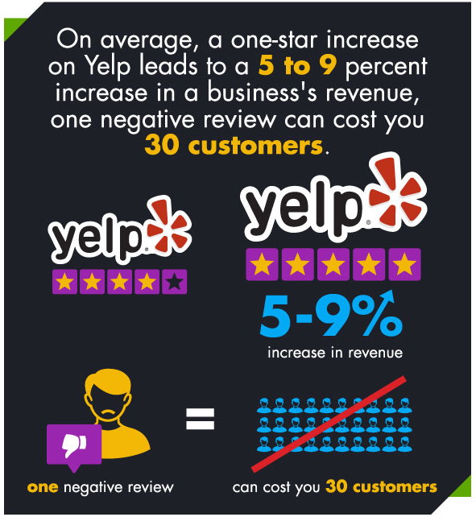
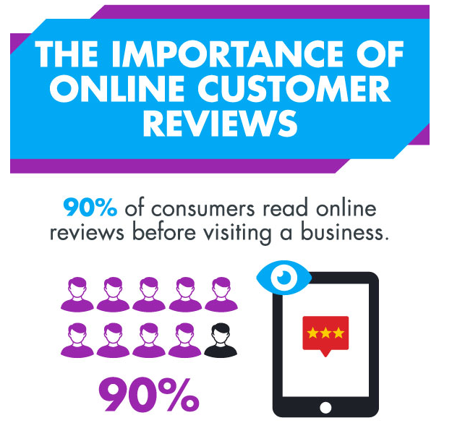
Why is it important?

Slide 4


How will we do it?
Structural data information
Final dataset
1 Main restaurant request
Picture URL
Picture information
2 Image recognition

Slide 5
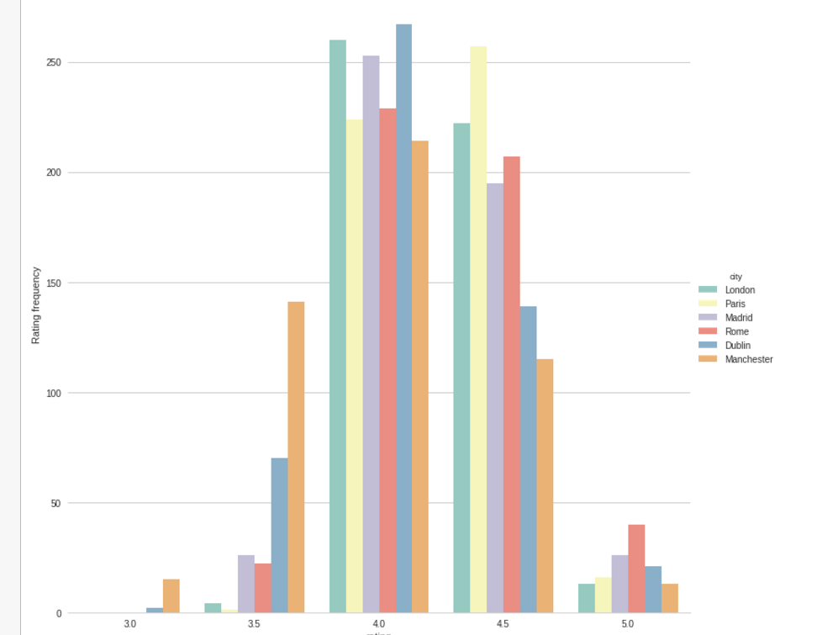
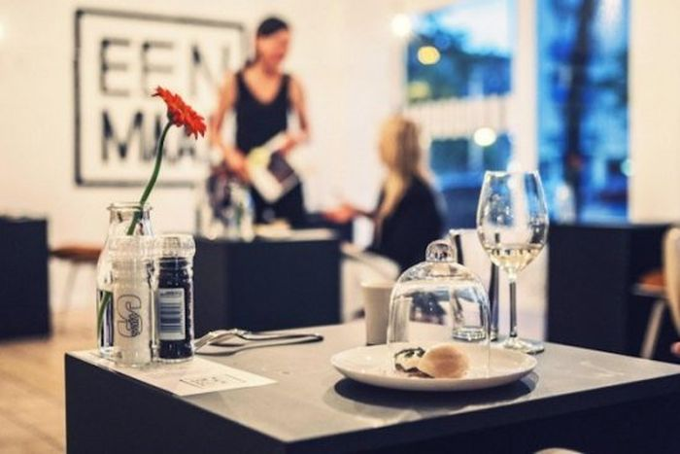
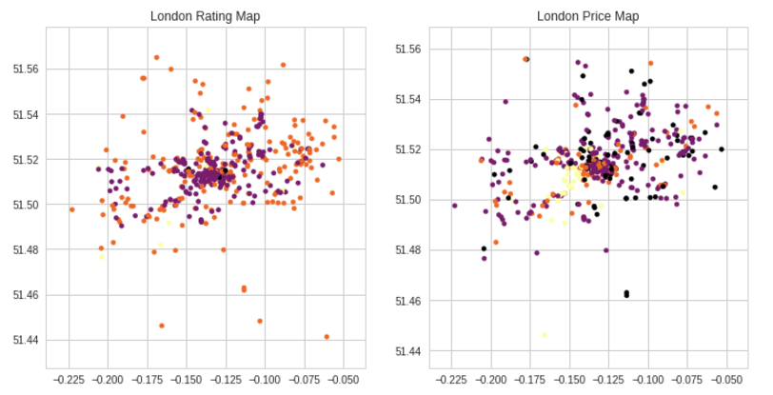
Data Exploration
Flower
Woman
Location
High explanatory power of cities
Glass
Potential creation of clustering variable of location
Most common color: white Pixel prop. 60%
Predominant primary color: Blue
STRUCTURED INFORMATION
UNSTRUCTURED INFORMATION
Yelp API
Google Cloud Vision
Impact
Location (Lon, Lat)
City
Telephone
Price
Number of Reviews
Restaurant type – high explanatory
Picture attributes:
Picture labels
+
-
Color information
Note: Green is the best color to have in your ad
-

Slide 6
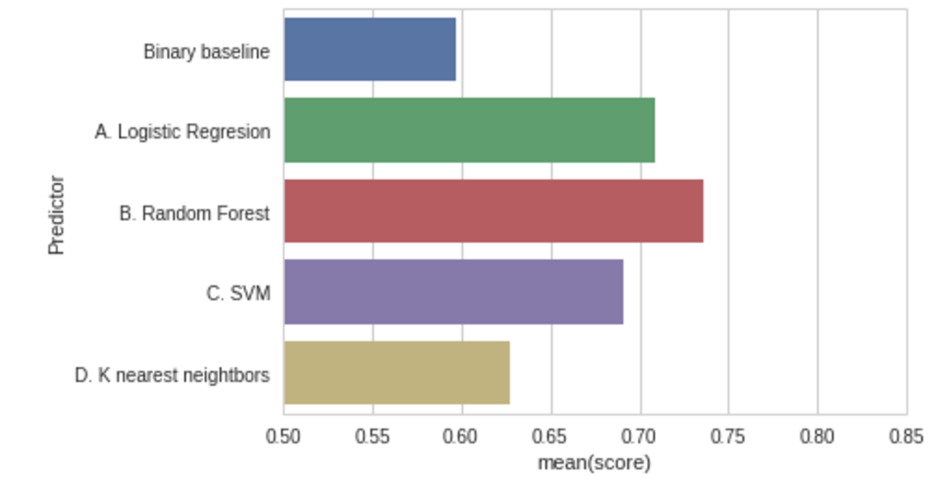
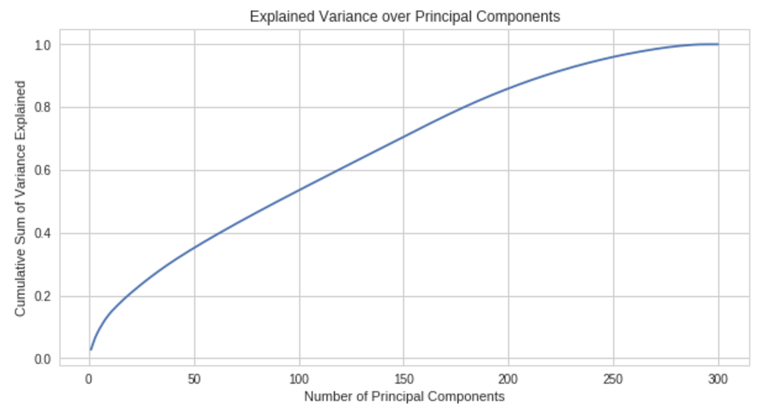
Modelling
In the modelling part of the project I trained logistic regression model, random forest, SVM and a KNN models.
All of them showed results highly above baseline. Specially random forest classifier shows the best results
KNN shows a low result, I hypothesized that this was due to the high dimensionality of data, for this I trained a PCA reduction and trained it with 66% of the features, results slightly increased.
PCA component analysis

Slide 7
Conclusions
APPLICATION OF THE RESULTS
WHERE WOULD IT APPLY?
Unfortunately this results are unable to show causality as many of the explanatory variables are not taken into account (food for example).
Online business with purchases just based on online experience (i.e. Deliveroo, Uber eat).
NEXT STEPS
PCA tune in
NLP of reviews
Lat, Lon clustering
Model missing values
Naive Bayes

